Slide 1
Metastatic Pancreatic Ductal Adenocarcinoma New perspective
Presented by
Dr, Karam Ibrahim Jeji

Slide 2
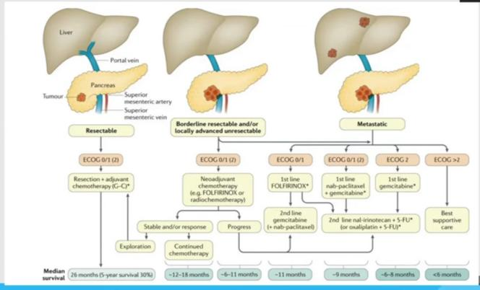
Therapeutic Approach

Slide 3
Systemic therapy 2nd line
Nanoliposomla Irinotecan ( NAPOLI_1 TRIAL )

Slide 4
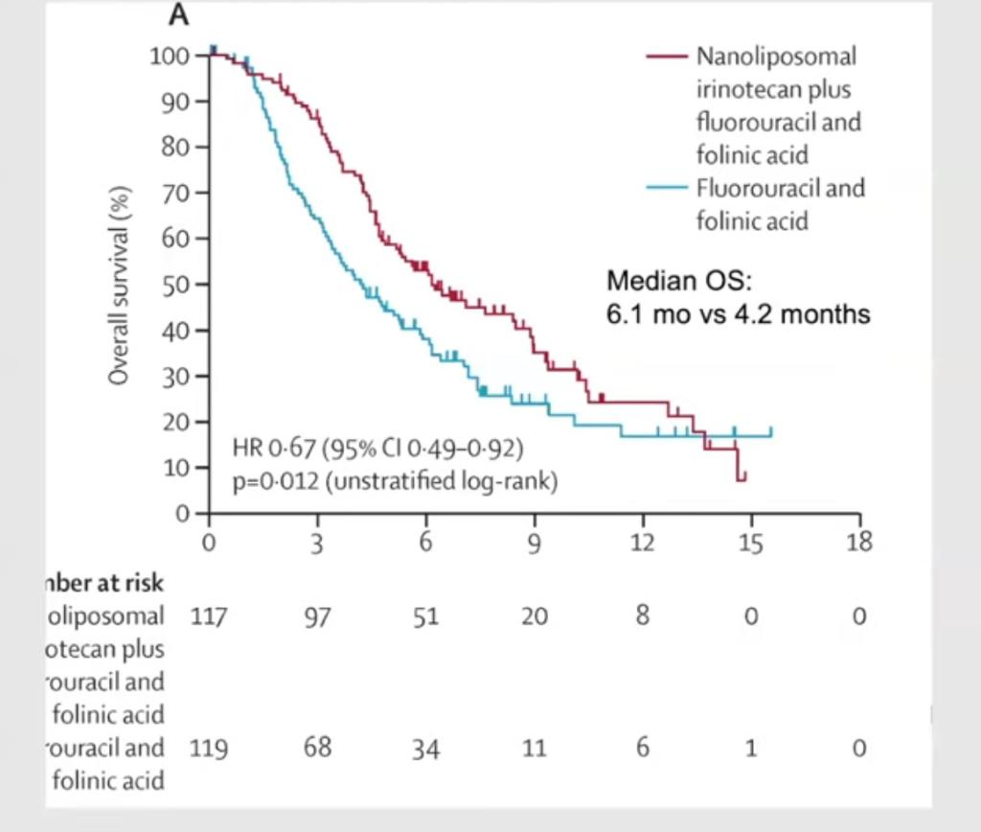
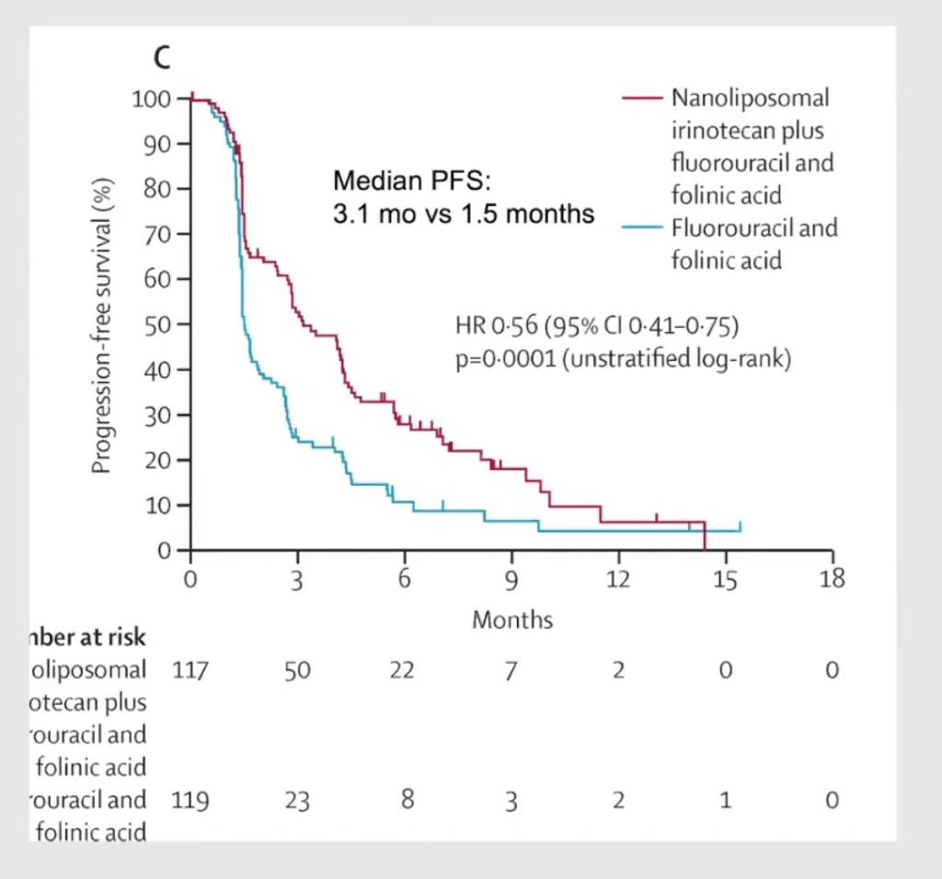
Cont.

Slide 6
NCCN GUIDELINES FOR ALL PATIENTS

Slide 7
Precision Oncology

Slide 8
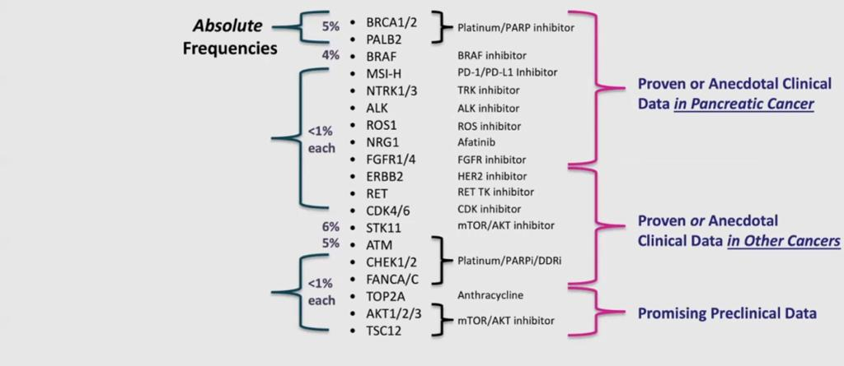
Molecular Subtyping Therapeutic Implication

Slide 9
Molecular Subtyping Therapeutic Implication

Slide 10
MSI High Pancreatic Cancer

Slide 11
Cont.

Slide 12
DDR Deficiencies predict OS in Platinum Treatment

Slide 13
BRCA1/2

Slide 14
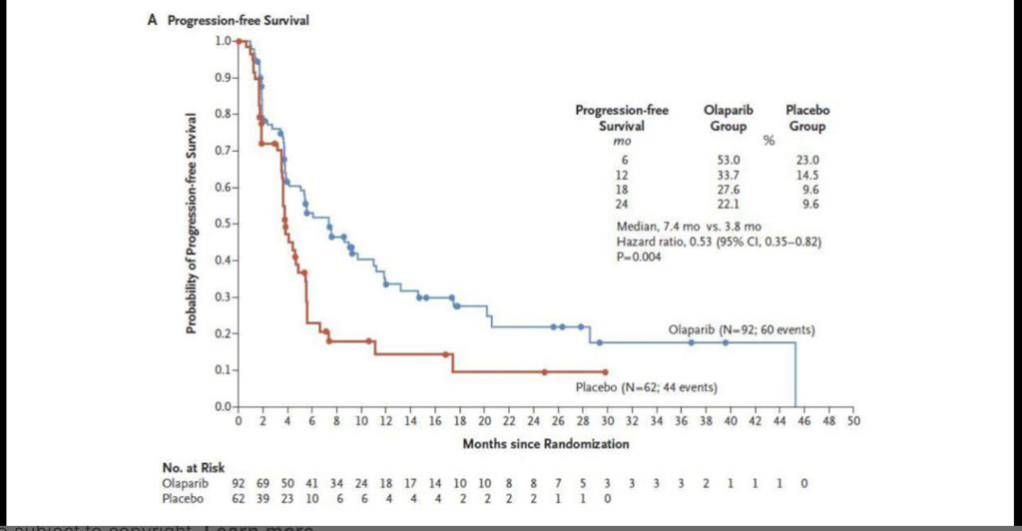
Cont.

Slide 15
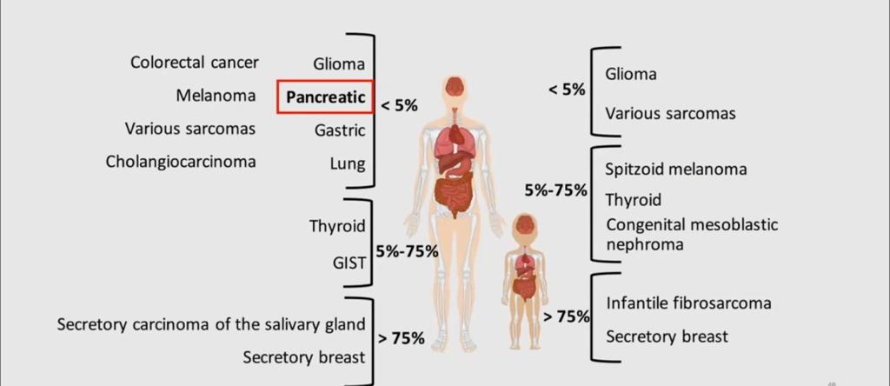
NTRK Gene Fusions Rare but Actionable

Slide 16
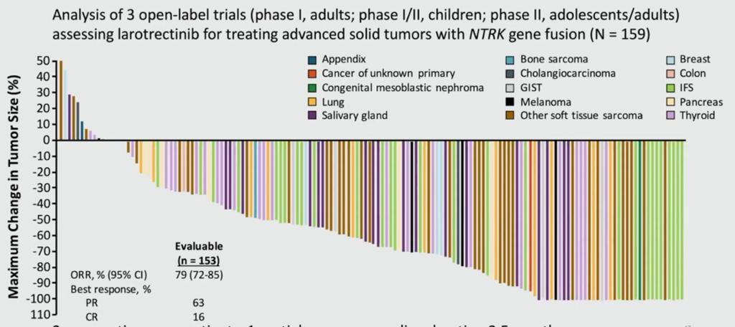
ALKA_372_001 , STARTRK_ 1 AND STARTRK_ 2

Slide 17
Cont.

Slide 18
Tumor microenvironment & Resistance to therapy

Slide 19
Can we make the Impossible …..Possible

Slide 20
Microbiome

Slide 21
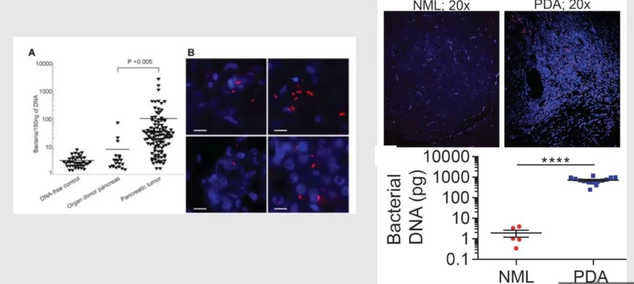
Cont.

Slide 22
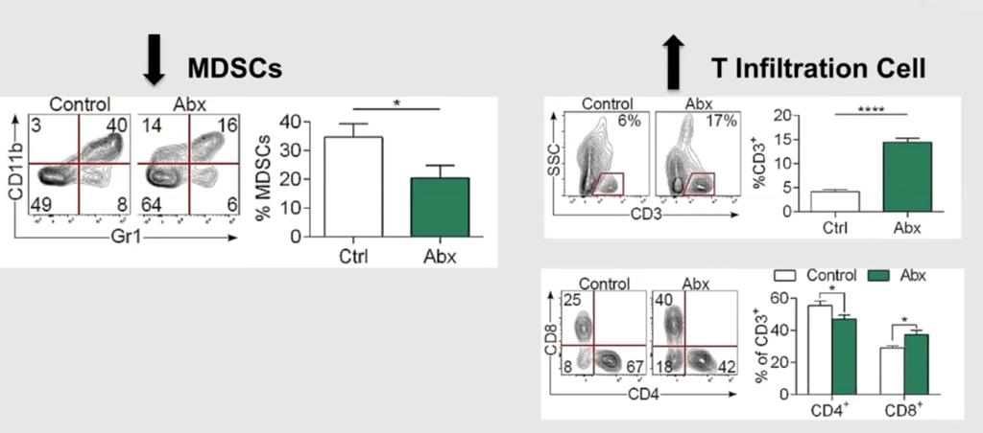
Microbiome Ablation and Immune Effect

Slide 24
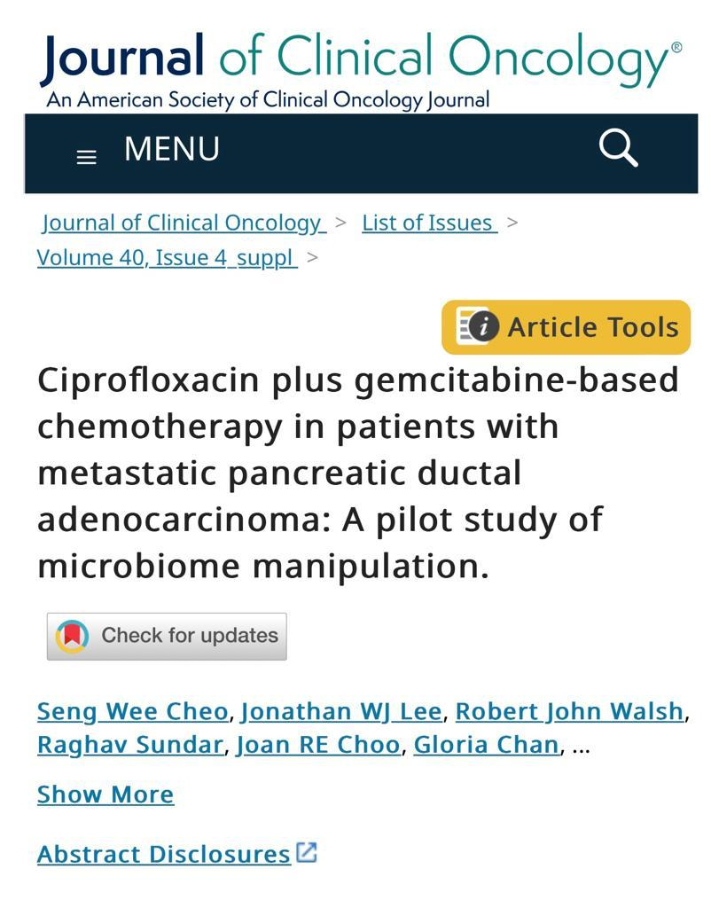
PILOT STUDY Ongoing
Phase1
Single arm
At National University Cancer Institute , Singapore
10 patients (from Mar.2019 till Feb.2024)
Weekly Nab_Paclitaxel 125mg/m2 (d1,d8,d15 )
with weekly gimcitabine 1000mg/m2 ( d1,d8,d15 )
with ciprofloxacine 500mg twice /daily
Primary end point RR and safety
Secondary end point PFS and OS

Slide 25
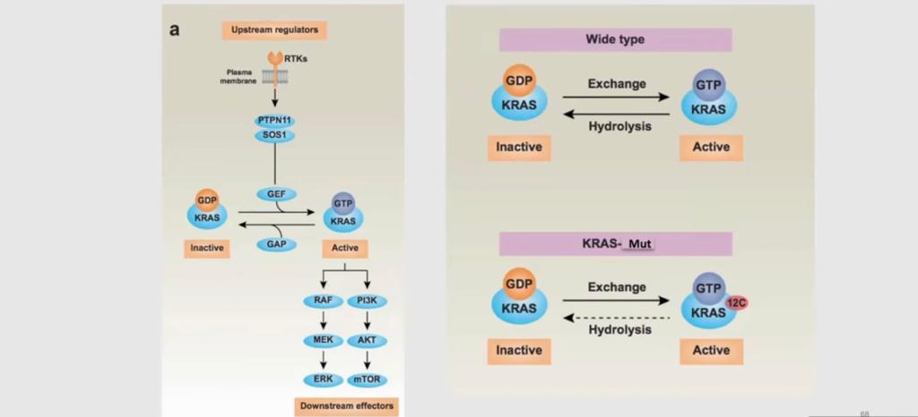
Targeting KRAS

Slide 26
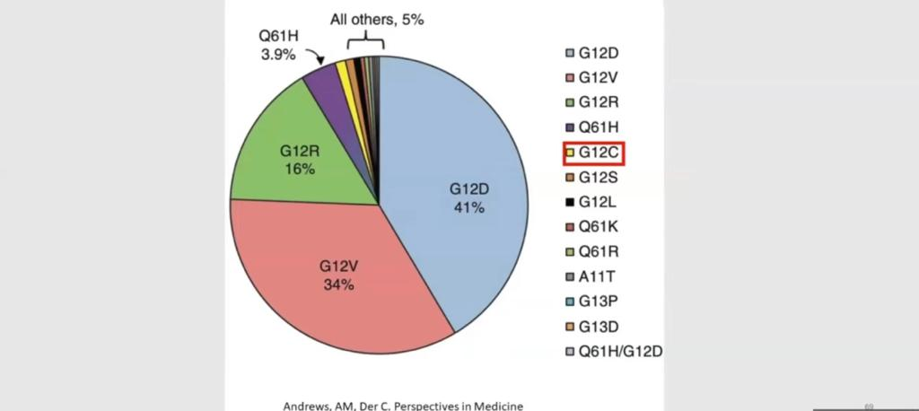
KRAS Subtype

Slide 27
KRYSTAL_1 TRIAL

Slide 28
Overcoming Resistance to KRAS G12C Inhibition

Slide 30
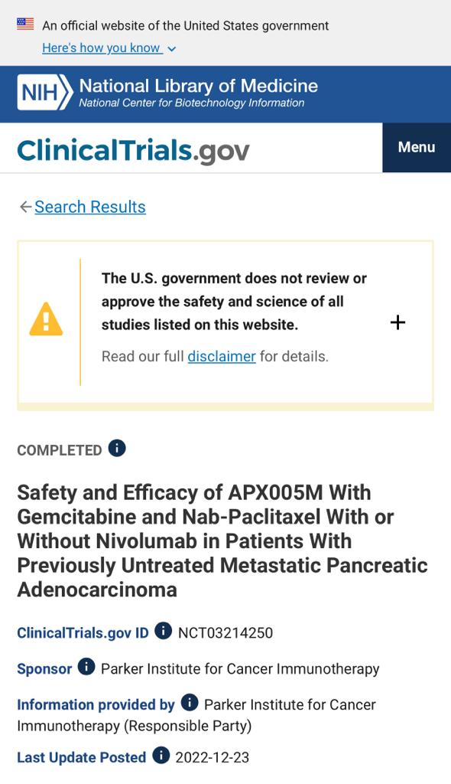

Slide 31
Promising immuno_chemotherapy
PRINCE TRIAL
>100 pts
Anti PD1 (NIVOLUMAB) + GEM &NAB_PACLITAXEL
Pro-CD40 (SOTIGALIMAB) + GEM &NAB_PACLITAXEL
Combination of Anti PD1 & Pro-CD40 with Chemo
Survival rate >1 yr( 57% for Anti PD1 …48% for Pro-CD40 …41% for combo )

Slide 32
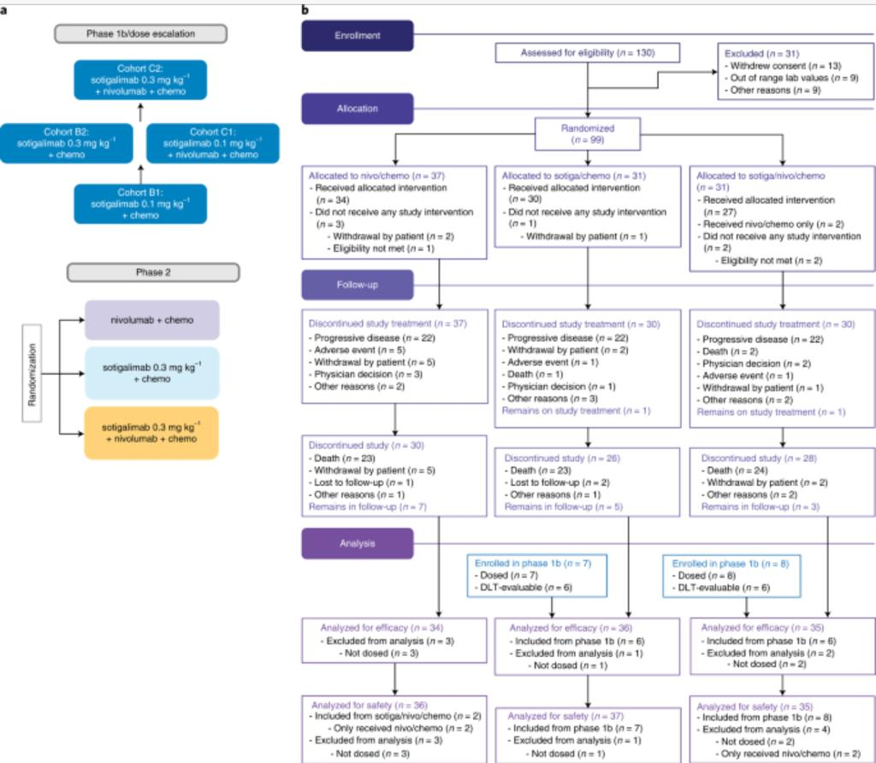
PRINCE TRIAL

Slide 33
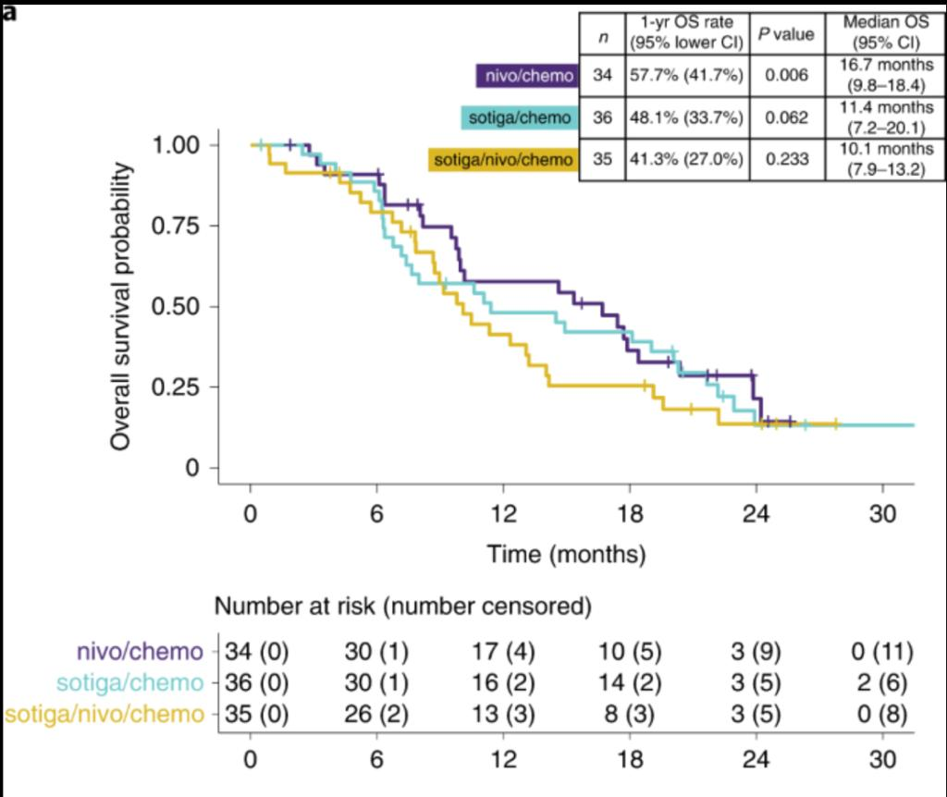
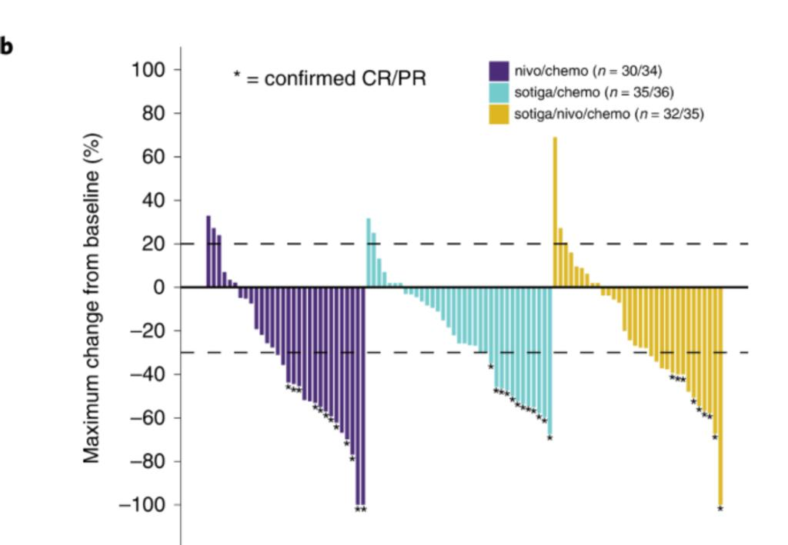
Cont.

Slide 34
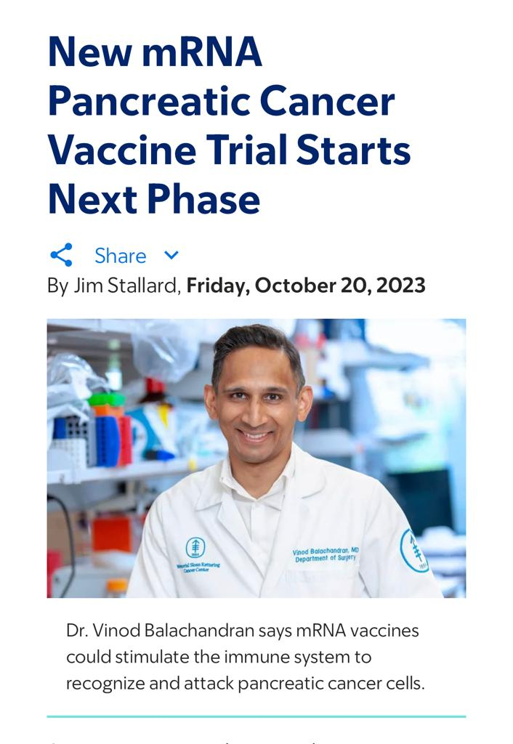

Slide 35
Reference
NCCN GUIDELINES
DEVITA_HELLMAN AND ROSENBERG
CLINICAL ONCOLOGY
NATIONAL CANCER ISTITUTE
JOHNS HOPKINS UNIVERSITY
COLORADO UNIVERSITY
PANCREAS TRIAL
JUORNAL OF CLINICAL ONCOLOGY
M.D Anderson
The Lancet Oncology

